Slide 1

Introduction to Operating Systems CS 1550
Spring 2022
Sherif Khattab
ksm73@pitt.edu
(Some slides are from Silberschatz, Galvin and Gagne ©2013)

Slide 2
Announcements
Upcoming deadlines:
Homework 11: due on 4/18
Project 3: Late due date on 4/13
Late penalty waived
Lab 4: due on 4/15
Quiz 3: due on 4/15
Homework 12: due on 4/25
Lab 5: due on 5/2
Project 4 and Quiz 4: due on 5/2
Bonus Homework: due on 5/2
Course Post-Test: due on 5/2

Slide 3
Muddiest Points (1/2)
when is the parity checked to see if there is a bit error
a little confused about parity example
How to flip the correct bits back that were changed with parity?
What is parity used for
ECC
What things move how using what in the disk
disk request time delay factors
transfer time/rotating time/seek time
I feel like rotational delay and actual transfer time are overlapped. The sector is spending time to rotate to the head, and at the same time, the head is rotating to find that sector. Are they moving towards each other at the same time?

Slide 4
Muddiest Points (2/2)
In the last top hat question, why the page table gets smaller if the page frames are larger. I understand that would mean less entries, but wouldn't each entry would be larger, making the overall table the same size?
What are RAIDs for?
Does RAID4 have any advantages over RAID5?
All of it, bro

Slide 5
Problem of the Day – Part 1
How does a file system handle errors?
Answer: Defense in Depth
multiple layers of error detection/correction

Slide 6
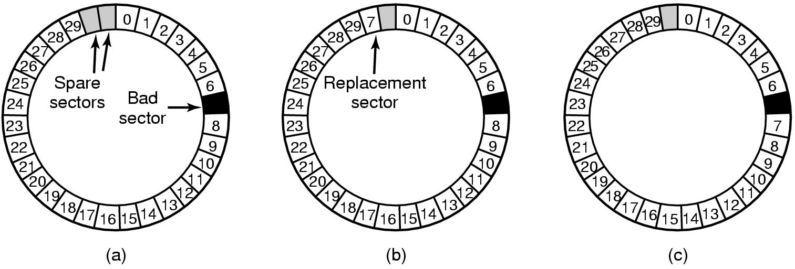
When good disks go bad…
Disks have defects
In 3M+ sectors, this isn’t surprising!
ECC helps with errors, but sometimes this isn’t enough
Disks keep spare sectors (normally unused) and remap bad sectors into these spares
If there’s time, the whole track could be reordered…

Slide 7
RAIDs, RAIDs, and more RAIDs
Stripe
strip
strip
RAID 0
(Redundant Array of Inexpensive Disks
RAID 1
(Mirrored copies)
RAID 4
(Striped with parity)
RAID 5
(Parity rotates through disks)

Slide 8
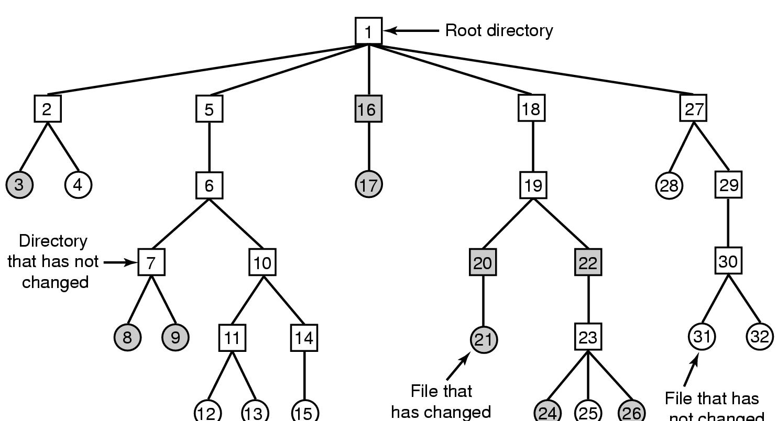
Backing up a file system
A file system to be dumped
Squares are directories, circles are files
Shaded items, modified since last dump
Each directory & file labeled by i-node number
File that has
not changed

Slide 9
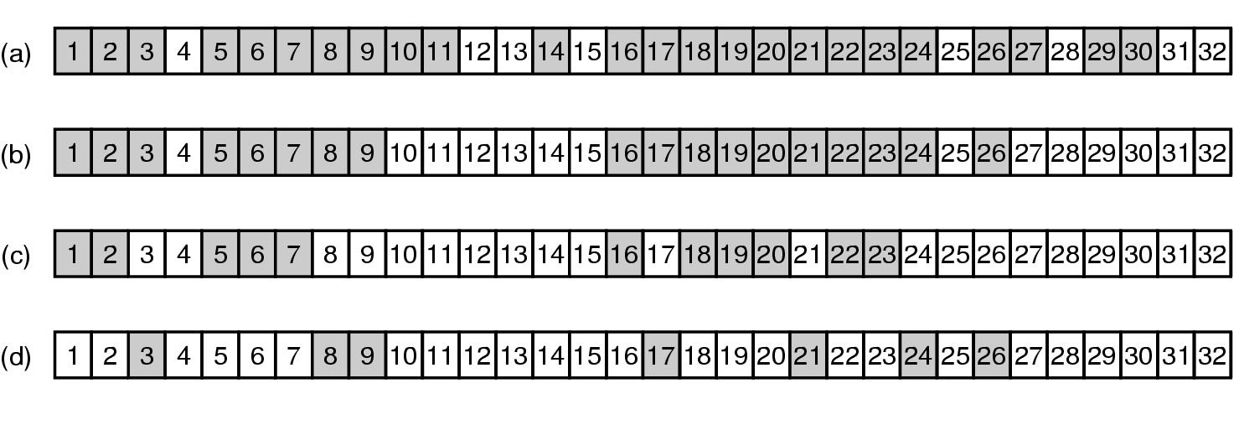
Bitmaps used in a file system dump

Slide 10
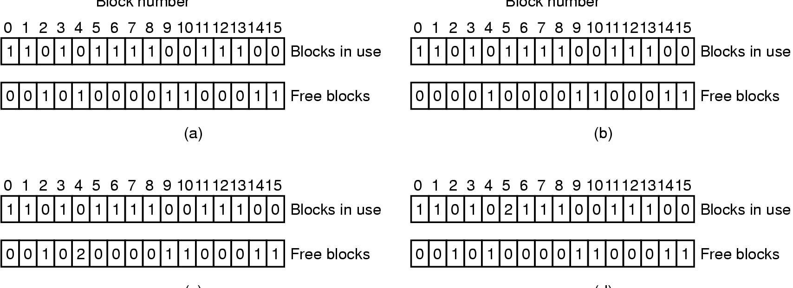
Checking the file system for consistency
Consistent
Missing (“lost”) block
Duplicate block in free list
Duplicate block in two files

Slide 11
Problem of the Day – Part 2
How does a file system hide disk access delays?
Answer: Caching

Slide 12
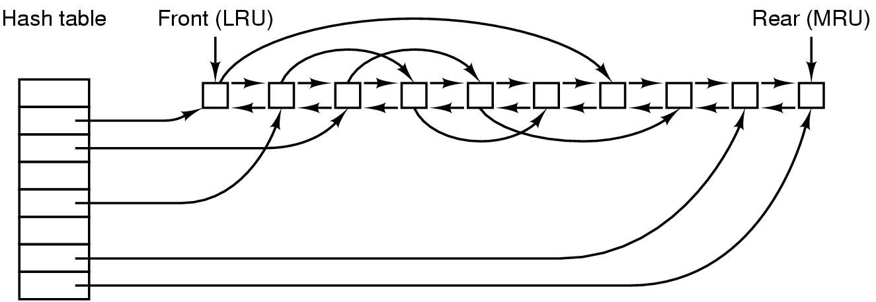
File block cache data structures

Slide 13
Log-structured file systems
Trends in disk & memory
Faster CPUs
Larger memories
Result
More memory -> disk caches can also be larger
Increasing number of read requests can come from cache
Thus, most disk accesses will be writes
LFS structures entire disk as a log
All writes initially buffered in memory
Periodically write these to the end of the disk log
When file opened, locate i-node, then find blocks
Issue: what happens when blocks are deleted?

Slide 14
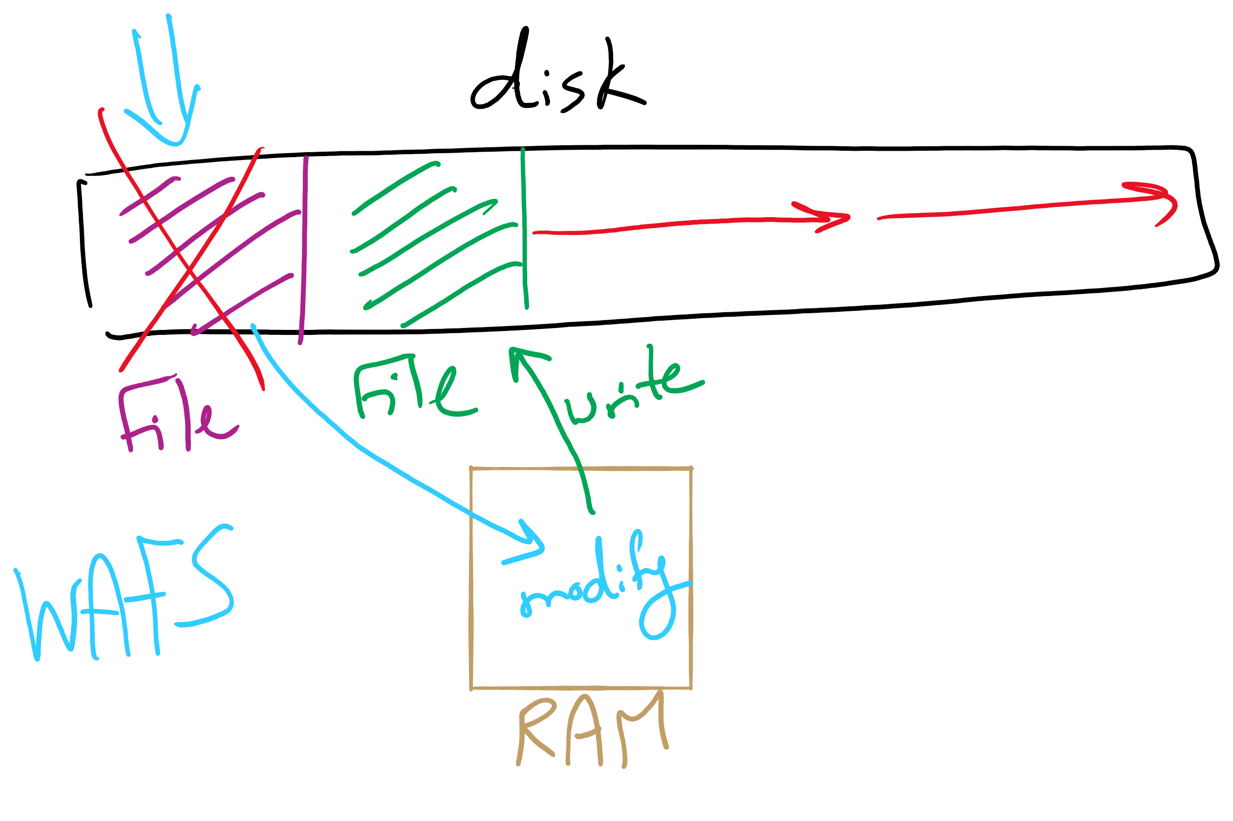
Log Structured File System

Slide 15
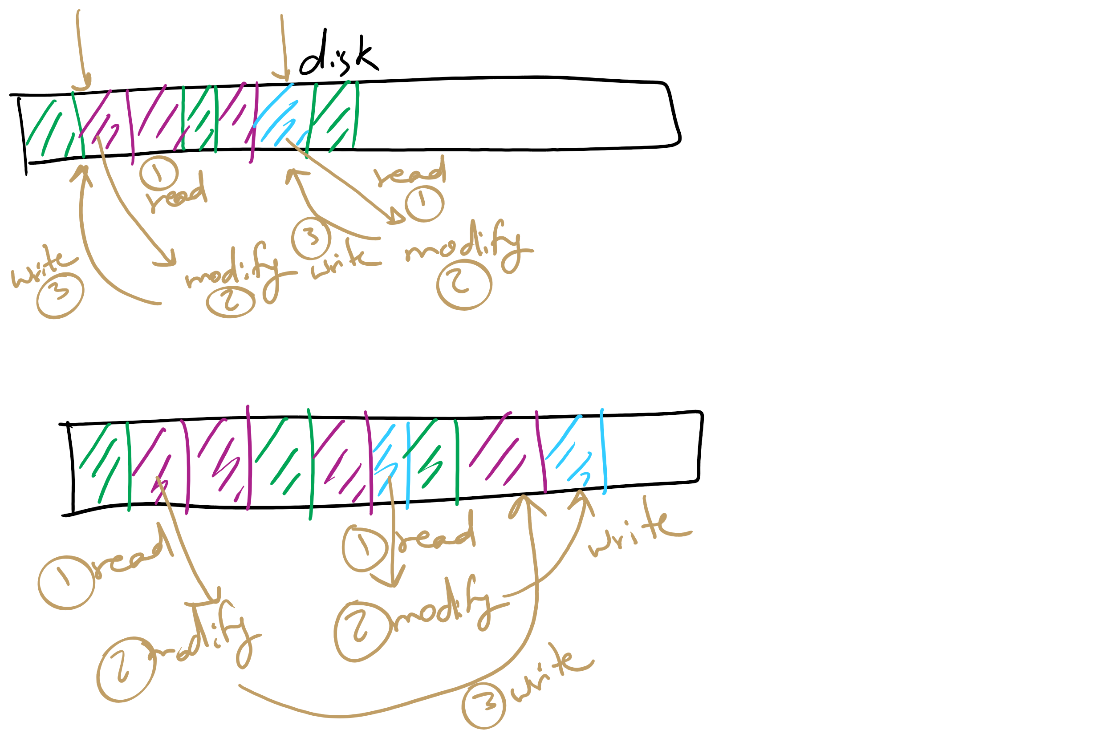
Log Structured File System

Slide 16
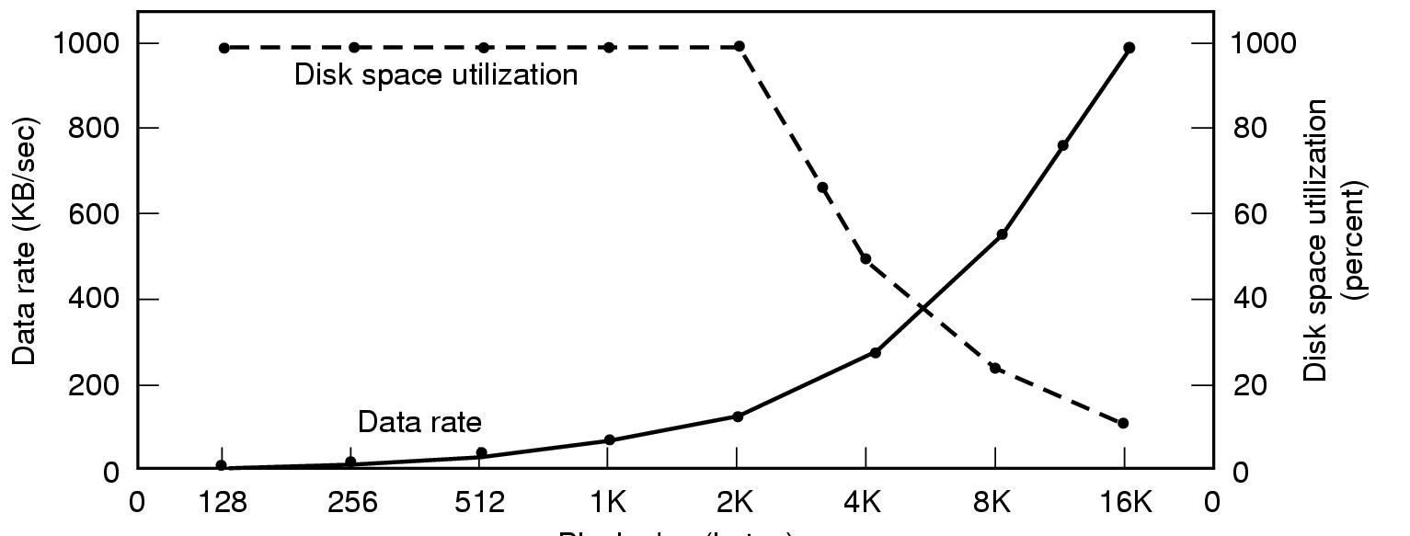
Disk block size
Dark line (left hand scale) gives data rate of a disk
Dotted line (right hand scale) gives disk space efficiency
All files 2KB
Block size

Slide 17
Problem of the Day – Part 3
How do device drivers program I/O devices?
Answer: three methods
polling
Interrupts
DMA

Slide 18
How are I/O devices connected?
Single-bus
All memory accesses go over a shared bus
I/O and RAM accesses compete for bandwidth
Dual-bus
RAM access over high-speed bus
I/O access over lower-speed bus
Less competition
More hardware (more expensive…)
CPU
Memory
I/O
CPU
Memory
I/O
This port allows I/O devices access into memory

Slide 19
Memory-Mapped vs. separate I/O Space
Memory
0xFFF…
I/O ports
0
Separate I/O & memory space
Memory-mapped I/O
Hybrid: both memory-mapped & separate spaces

Slide 20
Example: Dynamic Frequency on XScale

Slide 21
Programmed I/O example: printing a page
User
Printed page
Printed page
Printed page
ABCD EFGH
ABCD EFGH
ABCD EFGH
A
AB
Kernel
ABCD EFGH
ABCD EFGH

Slide 22
Polling
copy_from_user (buffer, p, count); // copy into kernel buffer
for (j = 0; j < count; j++) { // loop for each char
while (*printer_status_reg != READY)
; // wait for printer to be ready
*printer_data_reg = p[j]; // output a single character
}
return_to_user();

Slide 23
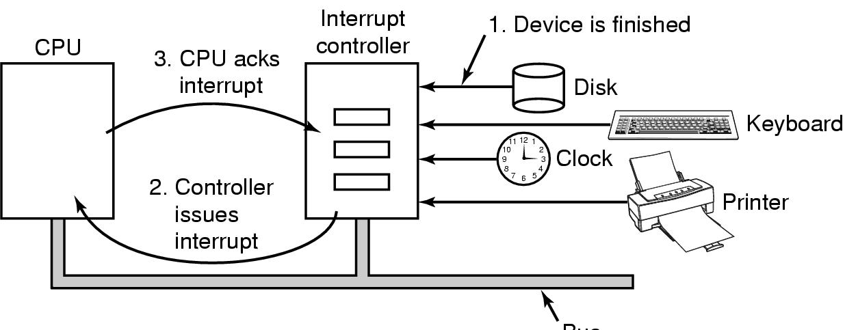
Hardware’s view of interrupts
Bus

Slide 24
Interrupt-driven I/O
copy_from_user (buffer, p, count);
j = 0;
enable_interrupts();
while (*printer_status_reg != READY)
;
*printer_data_reg = p[0];
scheduler(); // and block user
Code run by system call
if (count == 0) {
unblock_user();
} else {
j++;
*printer_data_reg = p[j];
count--;
}
acknowledge_interrupt();
return_from_interrupt();
Code run at interrupt time
(Interrupt handler)

Slide 25
What happens on an interrupt
Set up stack for interrupt service procedure
Ack interrupt controller, reenable interrupts
Copy registers from where saved
Run service procedure
(optional) Pick a new process to run next
Set up MMU context for process to run next
Load new process' registers
Start running the new process

Slide 26
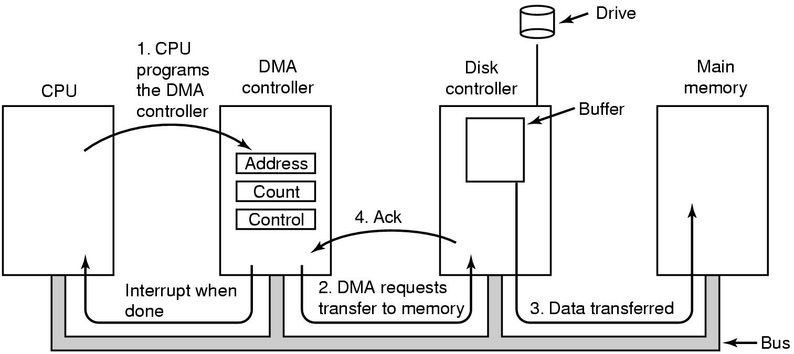
Direct Memory Access (DMA) operation

Slide 27
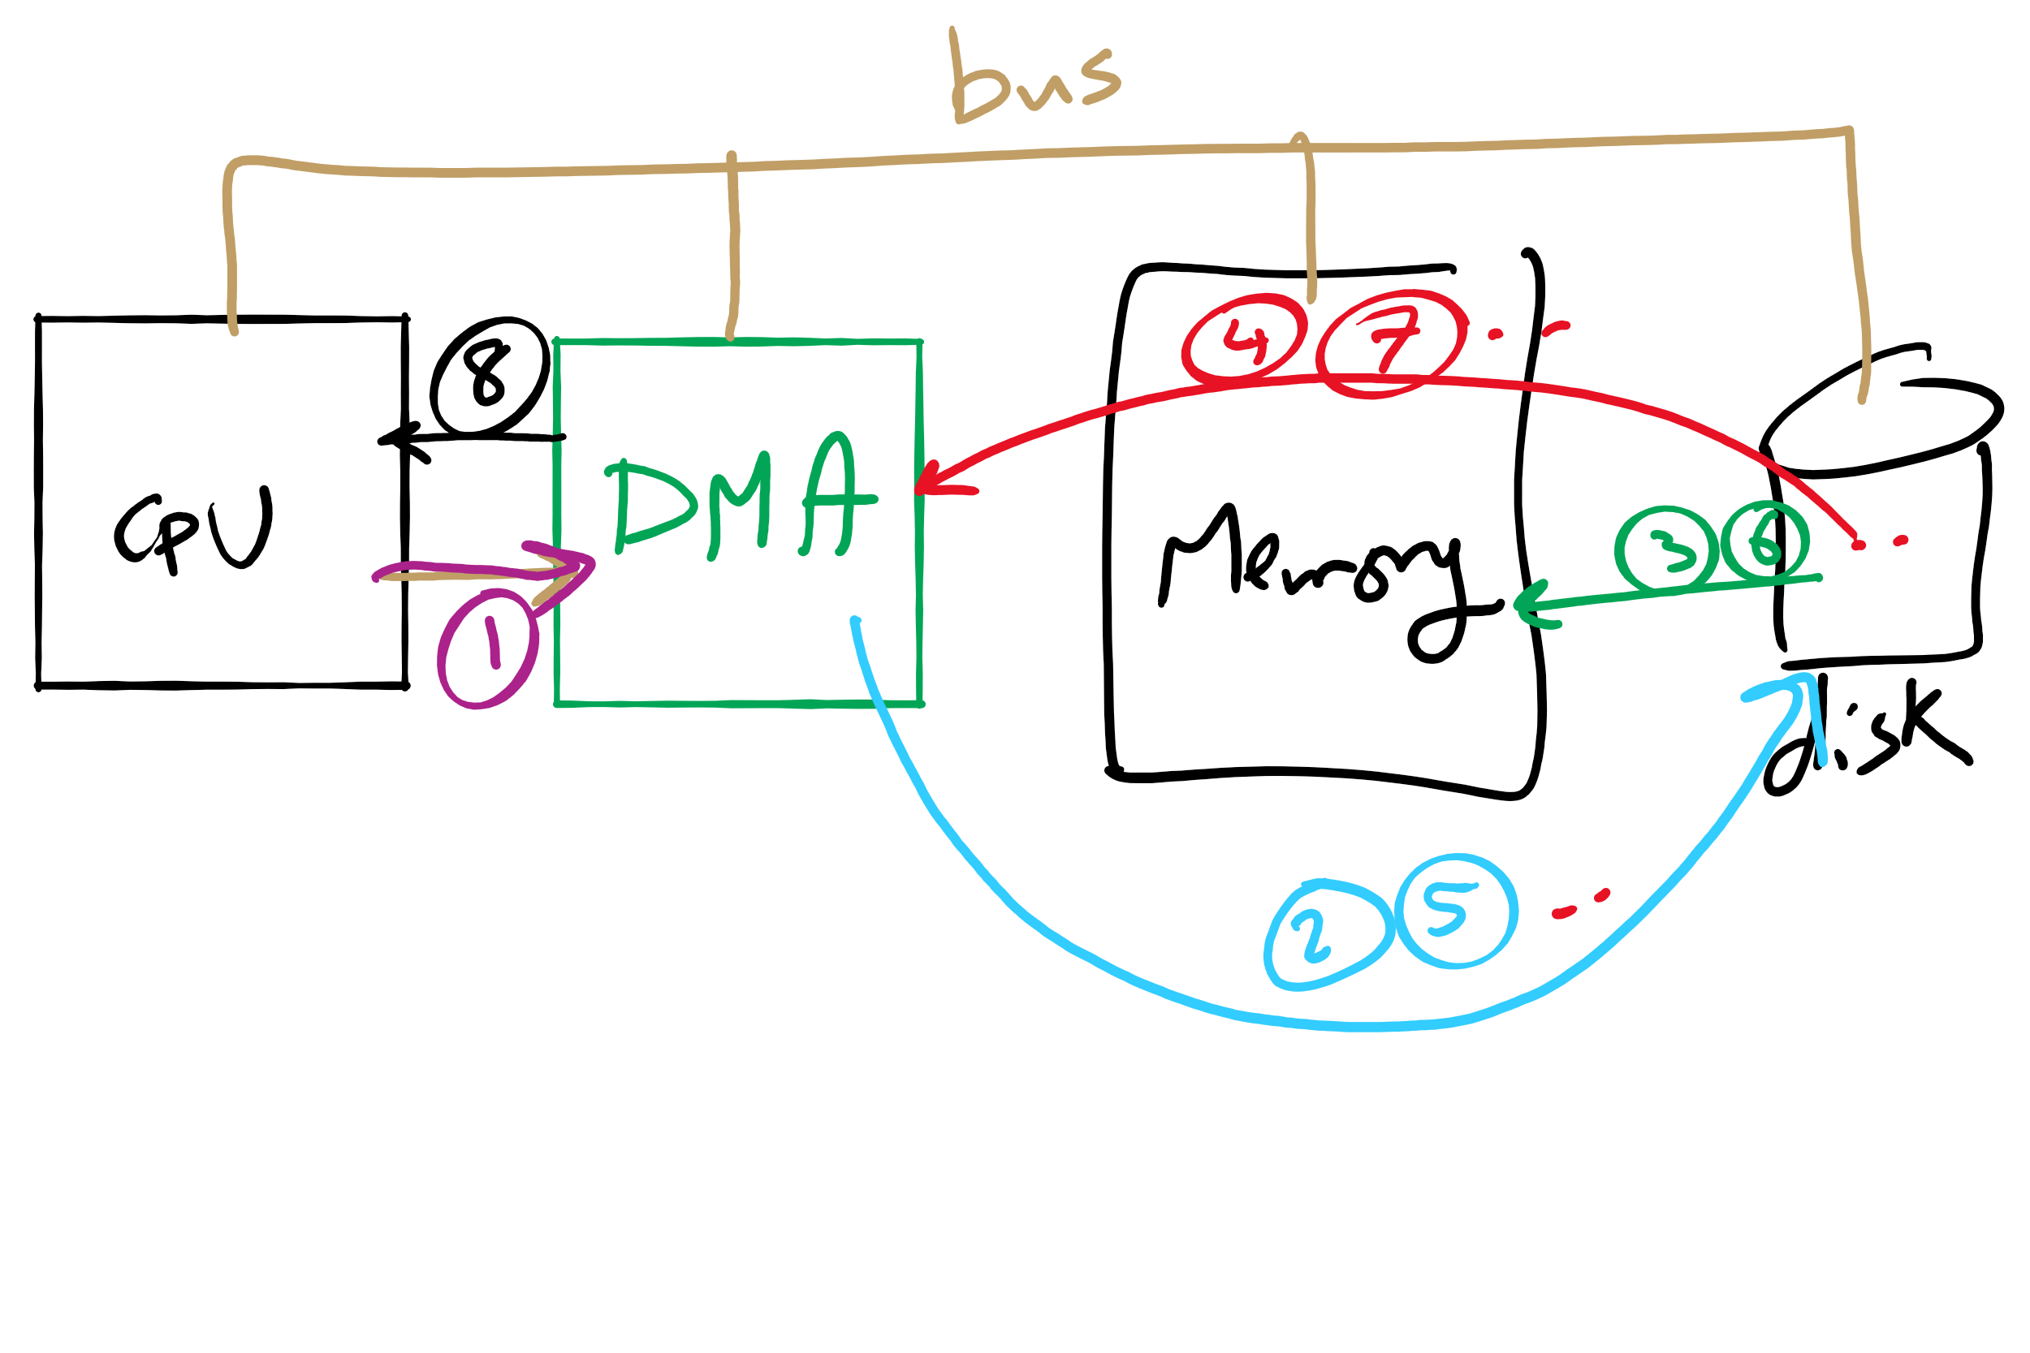
DMA

Slide 28
I/O using DMA
copy_from_user (buffer, p, count);
set_up_DMA_controller();
scheduler(); // and block user
Code run by system call
acknowledge_interrupt();
unblock_user();
return_from_interrupt();
Code run at interrupt time

Slide 29
Disk drive structure
Data stored on surfaces
Up to two surfaces per platter
One or more platters per disk
Data in concentric tracks
Tracks broken into sectors
256B-1KB per sector
Cylinder: corresponding tracks on all surfaces
Data read and written by heads
Actuator moves heads
Heads move in unison
head
sector
platter
track
cylinder
surfaces
spindle
actuator

Slide 30
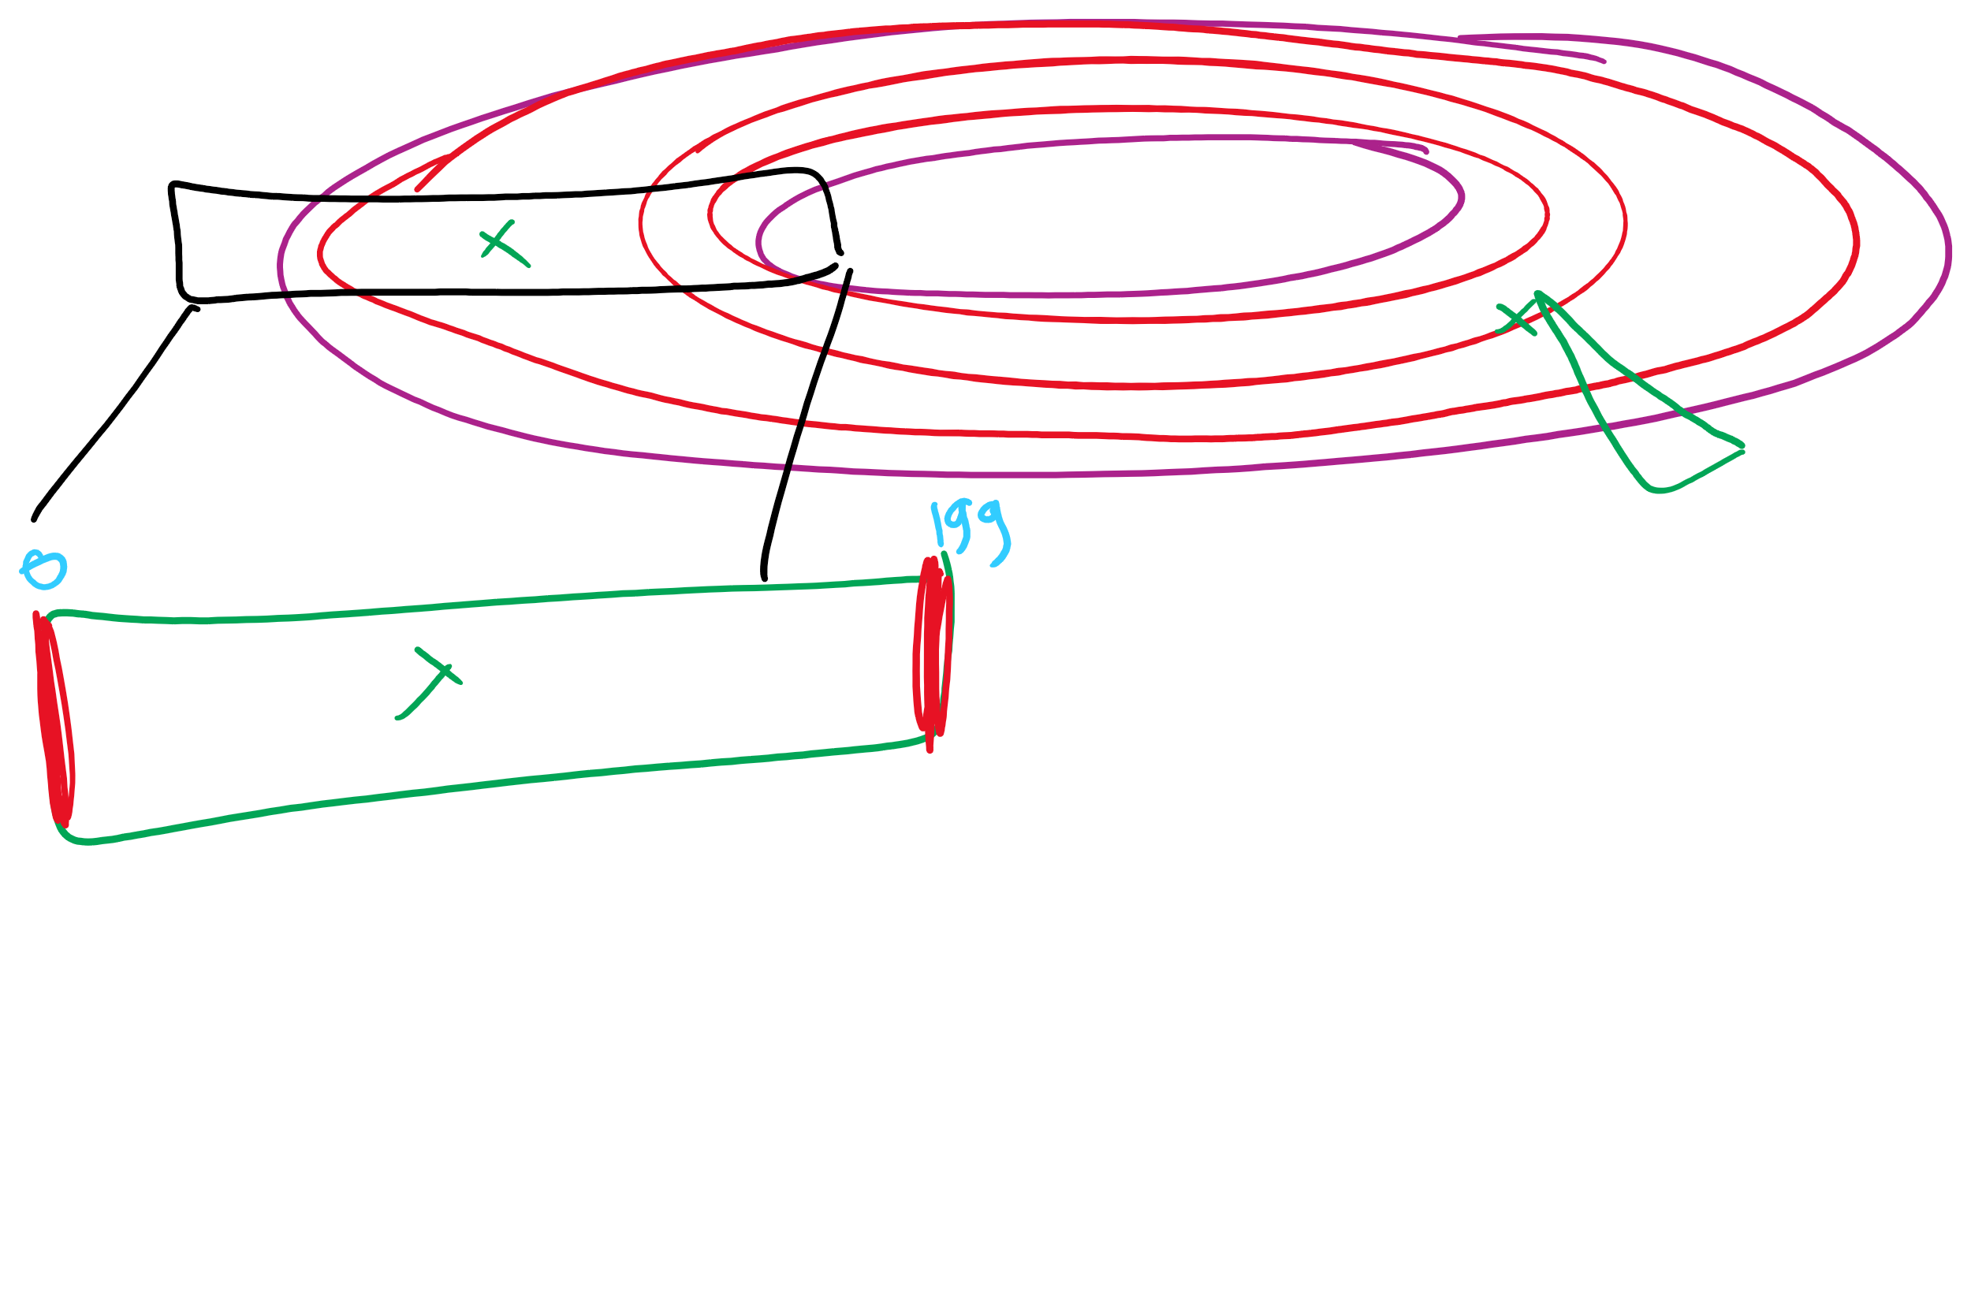
Disk scheduling algorithms
Schedule disk requests to minimize disk seek time
Seek time increases as distance increases (though not linearly)
Minimize seek distance -> minimize seek time
Disk seek algorithm examples assume a request queue & head position (disk has 200 cylinders)
Queue = 100, 175, 51, 133, 8, 140, 73, 77
Head position = 63
Outside edge
Inside edge
8
51
73
100
133
175
77
140
read/write head position
disk requests
(cylinder in which block resides)

Slide 31
First-Come-First Served (FCFS)
Requests serviced in the order in which they arrived
Easy to implement!
May involve lots of unnecessary seek distance
Seek order = 100, 175, 51, 133, 8, 140, 73, 77
Seek distance = (100-63) + (175-100) + (175-51) + (133-51) + (133-8) + (140-8) + (140-73) + (77-73) = 646 cylinders
read/write head start
100
175
51
133
8
140
73
77

Slide 32
Shortest Seek Time First (SSTF)
Service the request with the shortest seek time from the current head position
Form of SJF scheduling
May starve some requests
Seek order = 73, 77, 100, 133, 140, 175, 51, 8
Seek distance = 10 + 4 + 23 + 33 + 7 + 35 + 124 + 43 = 279 cylinders
read/write head start
73
77
51
8
133
100
140
175

Slide 33
SCAN (elevator algorithm)
Disk arm starts at one end of the disk and moves towards the other end, servicing requests as it goes
Reverses direction when it gets to end of the disk
Also known as elevator algorithm
Seek order = 51, 8, 0 , 73, 77, 100, 133, 140, 175
Seek distance = 12 + 43 + 8 + 73 + 4 + 23 + 33 + 7 + 35 = 238 cyls
read/write head start
51
8
73
77
100
133
140
175

Slide 34
C-SCAN
Identical to SCAN, except head returns to cylinder 0 when it reaches the end of the disk
Treats cylinder list as a circular list that wraps around the disk
Waiting time is more uniform for cylinders near the edge of the disk
Seek order = 73, 77, 100, 133, 140, 175, 199, 0, 8, 51
Distance = 10 + 4 + 23 + 33 + 7 + 35 + 24 + 199 + 8 + 43 = 386 cyls
read/write head start
73
77
100
133
140
175
8
51

Slide 35
C-LOOK
Identical to C-SCAN, except head only travels as far as the last request in each direction
Saves seek time from last sector to end of disk
Seek order = 73, 77, 100, 133, 140, 175, 8, 51
Distance = 10 + 4 + 23 + 33 + 7 + 35 + 167 + 43 = 322 cylinders
read/write head start
73
77
100
133
140
175
8
51

